Slide 1
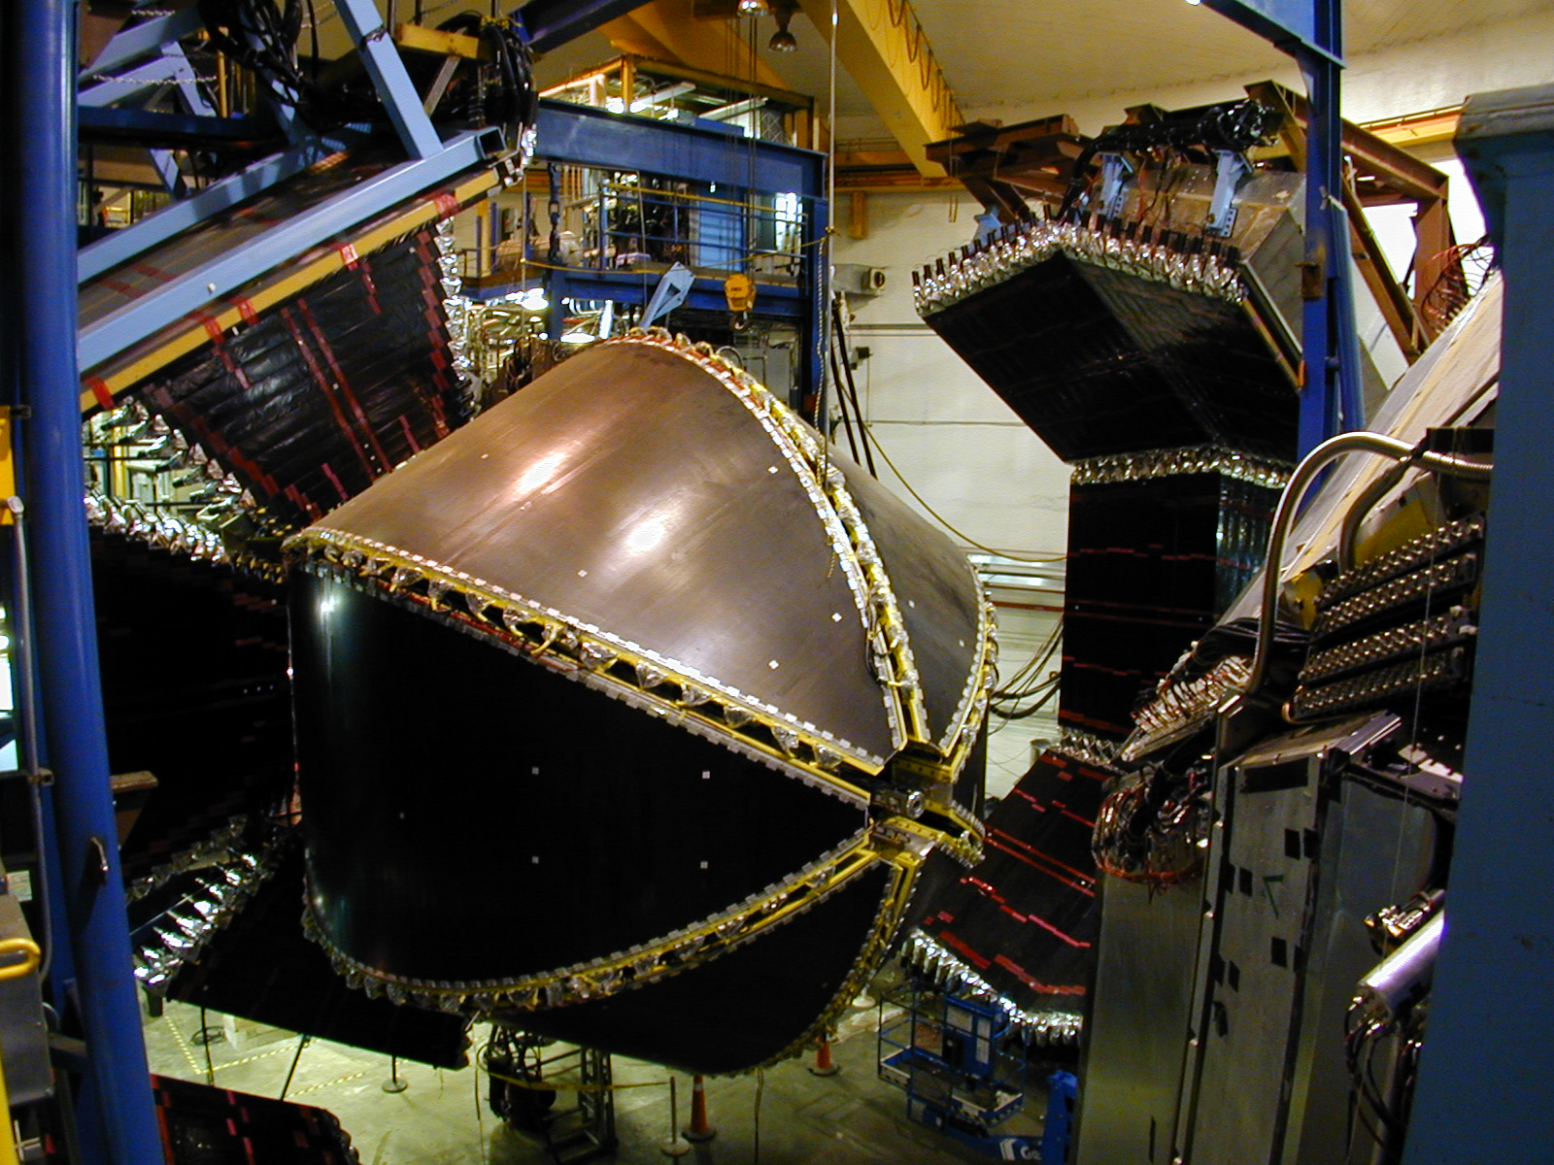

Transition form factors from meson electroproduction data
Victor I. Mokeev
Jefferson Lab
NSTAR2011 Conference at Jefferson Lab, May 17-21 2011

Slide 2
Outline
  Transition γ_{v}NN* electrocouplings as a window to confinement in baryons.
  Access to N* electrocouplings from analyses of various meson electroproduction channels.
  Phenomenological approaches for analyses of the CLAS data on Nπ and π⁺π⁻p electroproduction.
  Low lying N* electrocouplings from Nπ and π⁺π⁻p electroproduction channels.
  First results on electrocouplings of high lying N*’s with dominant Nππ decays.
  Conclusions and Outlook.

Slide 3
The studies of N* electrocouplings : motivation and objectives
Our experimental program seeks to determine
  γ_{v}NN* transition helicity amplitudes (electrocouplings) at photon virtualities 0.2< Q²<5.0 GeV² for most of the excited proton states analyzing major meson electroproduction channels combined.
This comprehensive information allows us to:
strong confinement
  pin-down active degrees of freedom in N* structure at various distances;
  study the non-perturbative strong interactions which are responsible for N* formation and their emergence from QCD;
  uniquely access the origin of more than 97% of dressed quark masses, their chromo- and electro- anomalous magnetic moments generated through dynamical chiral symmetry breaking, and explore the origin of confinement .
L.Chang et al, PRL 106, 072001 (2011)
quark anom.
electro magn.
moment
M_{E}=0.4 GeV
quark anom. chromo-
magn. moment
N* studies are key to the exploration
of non-perturbative strong
interactions and confinement.

Slide 4
N* parameters from analyses of exclusive electroproduction channels
Resonant amplitudes
Non-resonant amplitudes
π, η, ππ,..
π, η, ππ,..
γ_{v}
*
N*,△
+
N
N’
A_{3/2}, A_{1/2}, S_{1/2}
G_{M}, G_{E}, G_{C}
N’
N
  Separation of resonant/non-resonant contributions represents most challenging part, and can be achieved within the framework of reaction models.
  N* ‘s can couple to various exclusive channels with entirely different non-resonant amplitudes, while their electrocouplings should remain the same.
  Consistent results from the analyses of major meson electroproduction channels show that model uncertainties in extracted N* electrocouplings are under control.

Slide 5
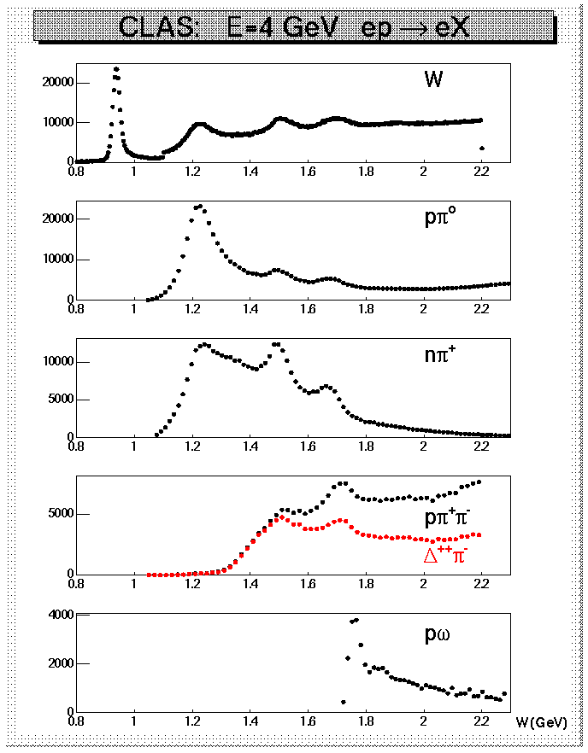
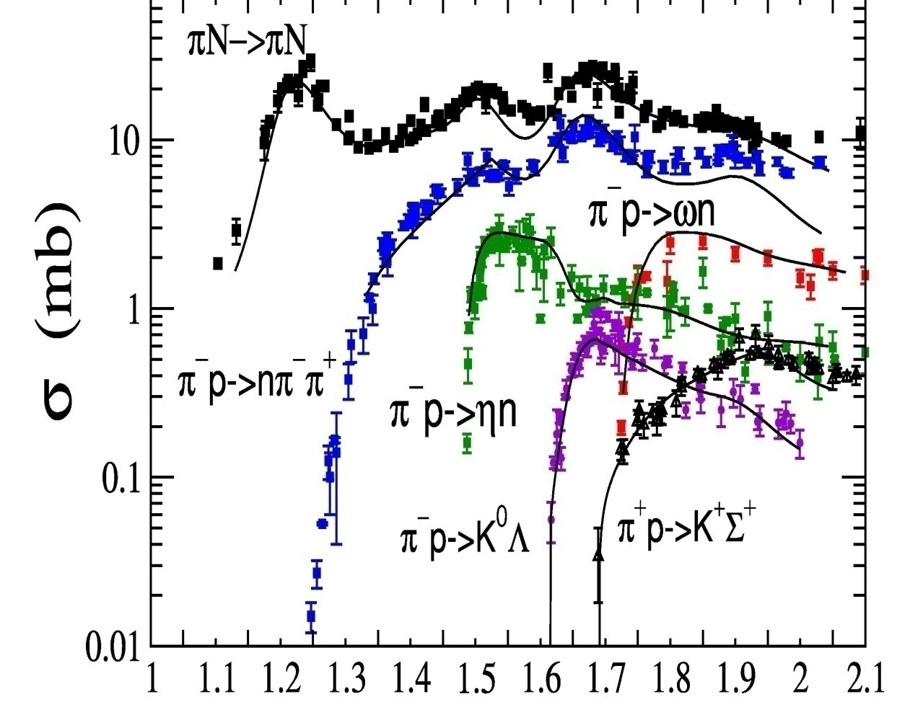
Evidence from data for a key role of Nπ & Nππ exclusive channels in meson electroproduction
CLAS data on yields of various meson
electroproduction channels (Q²<4.0 GeV²)
Cross sections of exclusive Nπ reactions
W (GeV)
Nπ/Nππ channels are strongly coupled by FSI.
N* analyses require coupled channel approaches, that account for MB↔MMB & MMB processes
Nπ/Nππ channels are major contributors to photo
electro and hadro production

Slide 6
Summary of the CLAS data on Nπ electroproduction off protons
Number of data points >116000, W<1.7 GeV, almost complete coverage of the final state phase space.
Observables | area, GeV² | Number of data points
dσ/dΩ(π⁰) | 0.16-1.45 3.0-6.0 | 39830 9000
dσ/dΩ(π⁺) | 0.25-0.60 1.7-4.3 | 25588 30 849
A_{e}(π⁰) , A_{t}(π⁰) | 0.25-0.65 | 3981
A_{e}(π⁺) , A_{t}(π⁺) | 0.40-065 1.7 - 3.5 | 1730 3 535
A_{et}(π⁰) | 0.25-0.61 | 1521
Low Q² results:
  I. Aznauryan et al., PRC 71, 015201 (2005); PRC 72, 045201 (2005).
High Q² results on Roper:
  I. Aznauryan et al., PRC 78, 045209 (2008).
Final analysis:
  I.G.Aznauryan,
  V.D.Burkert, et al.
  (CLAS Collaboration), PRC 80. 055203 (2009).
All data sets can be found in:
http://clasweb.jlab.org/physicsdb/

Slide 7
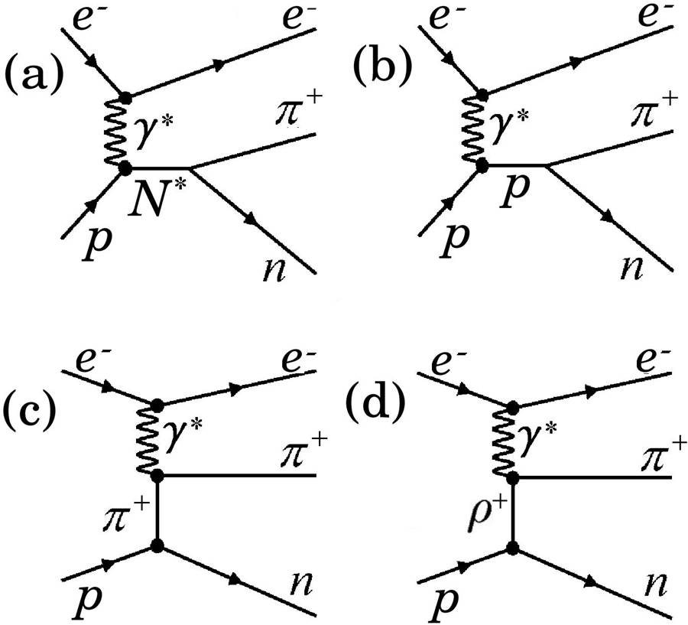
Unitary Isobar Model (UIM) for Nπ electroproduction
Based on MAID model
D.Drechsel et al.,NP, A645,145 (1999)
All well established N*’s with M<1.8 GeV, Breit-Wigner amplitudes.
Non-resonant Born terms:
  pole/reggeized meson t-channel exchange;
  s- and u-nucleon terms;
π
π
N
N
π
π
p
N
  Final-state πN rescattering
  In K-matirix approximation
ω,ρ,π
N
π
N
I. Aznauryan, Phys. Rev. C67, 015209 (2003)
π⁺

Slide 8
Fixed-t Dispersion Relations for invariant Ball amplitudes
γ*p→Nπ
The Ball amplitudes B_{i} ^{(±,0)} are invariant
functions in the transition current:
Dispersion relations for 6*3 invariant Ball amplitudes:
17 Unsubtracted Dispersion Relations
(i=1,2,4,5,6)
defined mostly by N*’s
1 Subtracted Dispersion
Relation
(i=3)

Slide 9
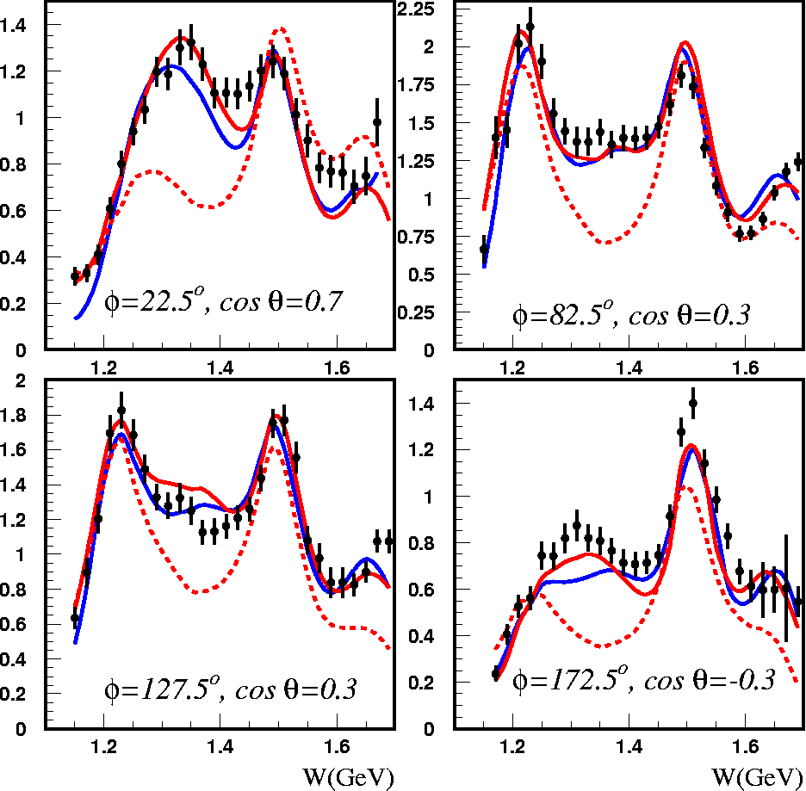
Fits to γp→π⁺n differential cross sections and structure functions
DR
DR
Q²=2.44 GeV²
Q²=2.05 GeV²
DR w/o P11
UIM
UIM
dσ/dΩ_{π}
L=0 Legendre moments from various structure functions

Slide 10
The CLAS data on π⁺π⁻p differential cross sections and description within the JM model
G.V.Fedotov et al, PRC 79 (2009), 015204
M.Ripani et al, PRL 91 (2003), 022002
full JM calc.
π⁺Δ⁰
ρp
π⁺F⁰₁₅(1685)
π⁻Δ⁺⁺
2π direct
π⁺D⁰₁₃(1520)

Slide 11
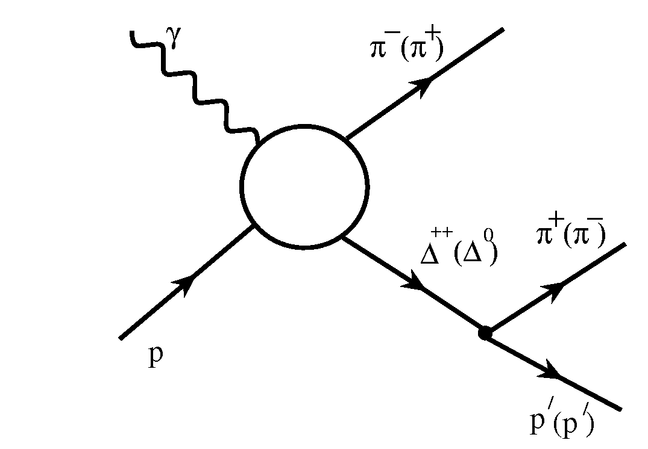
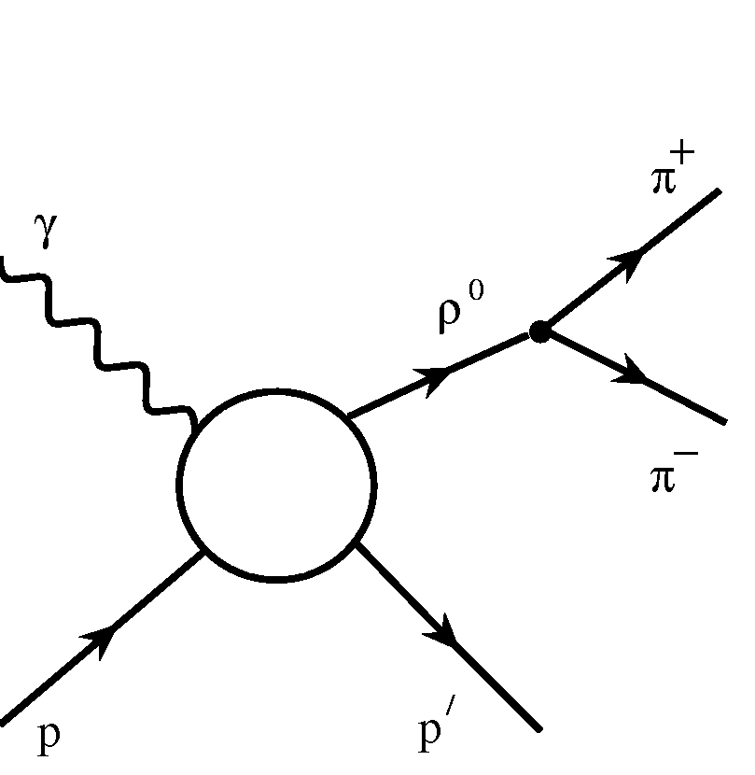
JLAB-MSU meson-baryon model (JM) for π⁺π⁻p electroproduction
V. Mokeev , V.D. Burkert, T.-S.H. Lee et al., Phys. Rev. C80, 045212 (2009)
Isobar channels included:
π⁻Δ⁺⁺
3-body processes:
  All well established N*s with πΔ decays and 3/2⁺(1720) candidate.
  Reggeized Born terms with effective FSI and ISI treatment (absorptive approximation).
  Extra πΔ contact term.
ρ⁰p
All well established N*s with ρp decays and 3/2⁺(1720) candidate.
Diffractive ansatz for non-resonant part and ρ-line shrinkage in N* region.

Slide 12
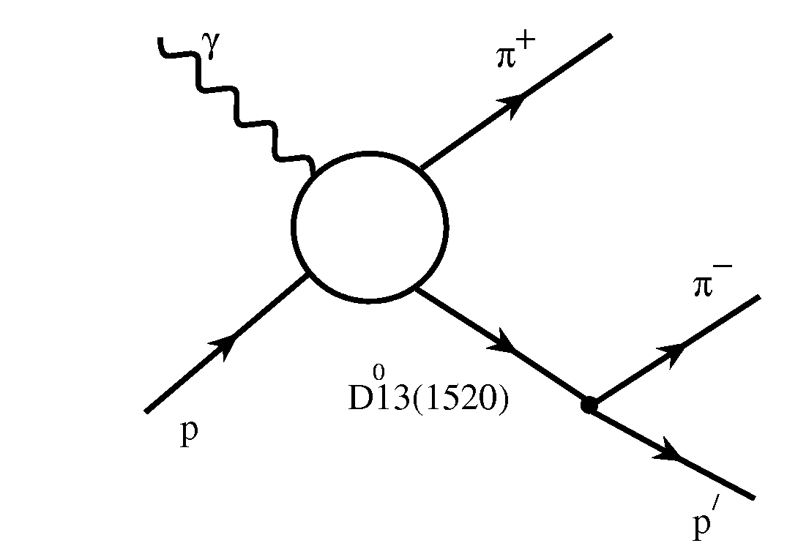
JLAB-MSU meson-baryon model (JM) for π⁺π⁻p electroproduction
3-body processes:
Isobar channels included:
(π⁻)
π⁺D⁰₁₃(1520), π⁺F⁰₁₅(1685), π⁻P⁺⁺₃₃(1640) isobar channels observed for the first time in the CLAS data at W > 1.5 GeV.
(P⁺⁺33(1640))
(π⁺)
F⁰15(1685)
Unitarized Breit-Wigner Anstaz for resonant amplitudes
I.J.R.Aitchison, Nuclear Physics , A189 (1972), 417
Inverse of JM unitarized N* propagator:
N*_{α}
N*_{α}
diagonal
Off-diagonal transitions incorporated into JM:
N*_{α}
N*_{β}
S₁₁(1535) ↔ S₁₁(1650)
D₁₃(1520) ↔ D₁₃(1700)
3/2⁺(1720) ↔ P₁₃(1700)
off-diagonal

Slide 13
JLAB-MSU meson-baryon model (JM) for π⁺π⁻p electroproduction
Direct 2π production required by unitarity:
Most relevant
at W<1.60 GeV.
Negligible at
W>1.70 GeV
Lorentz invariant contraction
of the initial and the final
particle spin-tensors
exponential propagators for
two unspecified exchanges
Magnitudes and relative
phases fit to the data
phases=0
phases fit to the data
W=1.51 GeV
Q²=0.65 GeV²
W=1.51 GeV
Q²=0.65 GeV²

Slide 14
Resonant and non-resonant parts of π⁺π⁻p cross sections as determined from the CLAS data fit within the framework of JM model
full cross sections
resonant part
non-resonant part

Slide 15
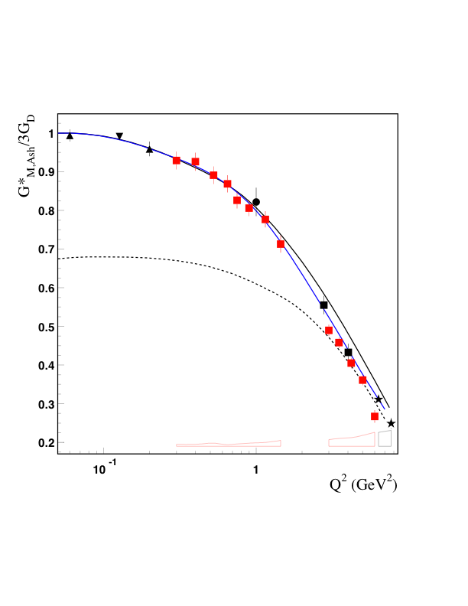
NΔ Transition Form Factor – G_{M.} Meson-baryon dressing vs Quark core contribution in EBAC analysis.
One third of G*_{M} at low Q² is due to contributions from meson–baryon (MB) dressing:
CLAS
Hall A
Hall C
MAMI
Bates
Meson-
Baryon
Cloud
Effect
bare quark core
Within the framework of relativistic QM [B.Julia-Diaz et al., PRC 69, 035212 (2004)], the bare-core contribution is very well described by the three-quark component of wave function
Q²=5GeV²

Slide 16
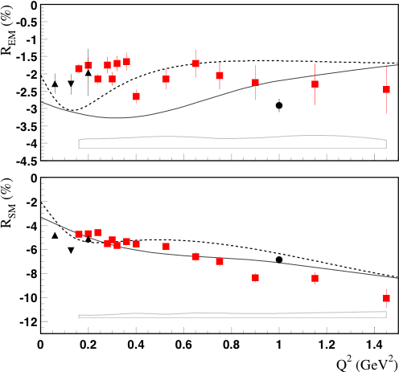
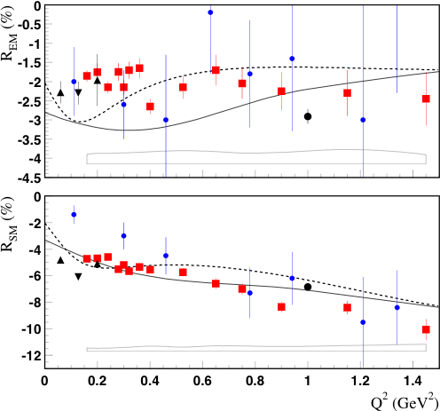
Q² dependence of NΔ Transition amplitudes
Quadrupole Ratios
LQCD (C.Alexandrou et al.)
CLAS
Hall A
Hall C
MAMI
Sato, Lee
0.2
6.0
No sign for onset of asymptotic behavior, R_{EM}→+100%, R_{SM}→ const.
R_{EM} remains negative and small, R_{SM} becoming more negative with Q².
Meson-baryon contributions needed to describe multipoles.
LQCD shows same trend as data but discrepancies for R_{SM} at low Q²

Slide 17
γ_{v}NN* electrocouplings from the CLAS data on Nπ/Nππ electroproduction
Nππ CLAS preliminary.
A_{1/2}
S_{1/2}
Nπ CLAS
I. Aznauryan,V. Burkert, et al., PRC 80,055203 (2009).
P₁₁(1440)
P₁₁(1440)
Nπ world
V. Burkert, et al., PRC 67,035204 (2003).
A_{3/2}
A_{3/2}
D₁₃(1520)
Nπ Q²=0, PDG.
Nπ Q²=0, CLAS
F₁₅(1685)
M. Dugger, et al., PRC 79,065206 (2009).
  Good agreement between the electrocouplings obtained from the Nπ and Nππ
  channels. N* electrocouplings are measurable and model independent quantities.

Slide 18
Structure of P₁₁(1440) from analyses of the CLAS results
Quark models:
I. Aznauryan LC
S. Capstick LC
S_{1/2}
Relativistic
covariant
approach by
G.Ramalho /F.Gross .
A_{1/2}
EBAC-DCC
MB dressing
(absolute values).
  The electrocouplings are consistent with P₁₁(1440) structure as a combined contribution of: a) quark core as a first radial excitation of the nucleon as a 3-quark ground state, and b) meson-baryon dressing.
  Information on complex values of γ_{v}NN* electrocouplings is needed in order to account consistently for meson-baryon dressing in resonance structure .
  Complex γ_{v}NN* electrocoupling values can be obtained in future data fit with restrictions on N* parameters from the EBAC-DCC coupled channel analysis.

Slide 19
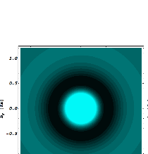
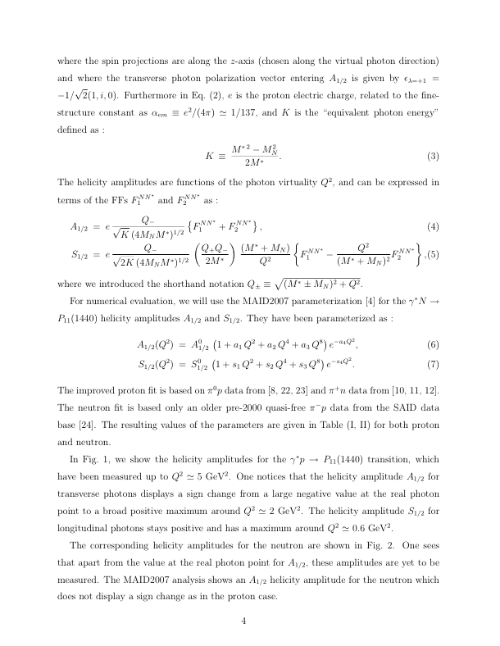
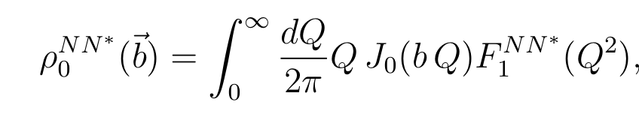
Transition charge density of the “Roper”
Tiator, Vanderhaeghen, PLB672, 344,2009
γp→N⁺(1440)P₁₁ in LF helicity +1/2→ +1/2 are induced dominantly by up quarks in central region of radius ~0.4 fm, and by down quarks in an outer band which extends up to ~1fm.
Light (dark) regions: positive (negative) charge densities

Slide 20
Structure of D₁₃(1520) from analysis of the CLAS data
A_{3/2}
A_{1/2}
S_{1/2}
MB dressing abs val. (EBAC)
M.Giannini/E.Santopinto
hCQM
at Q²>2.0 GeV² electrocouplings are consistent with D₁₃(1520) structure as three dressed
quarks in orbital excitation with L=1 .
sizable meson-baryon cloud at Q²<1.0 GeV²
The data on A_{1/2} electrocoupling at Q²>2.0 GeV² for the first time offer almost direct access to quark core. They are of particular interest for the description of N* structure based on QCD .

Slide 21
γ_{v}NN*(1535)S₁₁ electrocouplings
CLAS pη
CLAS nπ+
HallC pη
LC SR
LCQM
CLAS pη
CLAS nπ+
Analysis of pη channel assumes S_{1/2}=0
Branching ratios: β_{Nπ} = β_{Nη} = 0.45
A_{1/2} (Q²) from Nπ and pη are consistent
First extraction of S_{1/2}(Q²) amplitude
QCD-based LQCD & LCSR calculations (black solid lines) by Regensburg
Univ. Group reproduces data trend at Q²>2.0 GeV²
Successful description of S₁₁(1535) electrocouplings based on OCD!
See V.Braun talk for all details

Slide 22
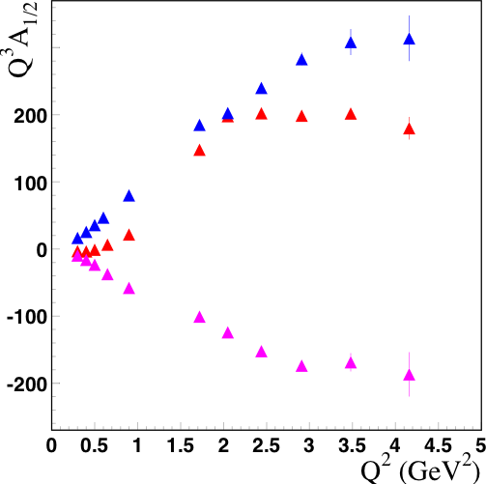
A new regime in N* electroexcitation at Q²>3.5 GeV²?
Data appear to reach a
plateau at Q²>3.5 GeV², but conclusive tests require higher Q²
S₁₁
P₁₁
Transition to photon interactions with
dressed quarks?
D₁₃

Slide 23
N* decay parameters to Nππ final states from the CLAS π⁺π⁻p electroproduction data
D₁₃(1520)
Parameters | CLAS π⁺π⁻p electro production data | PDG
Γ total, MeV | 126±7 | 100-125
πΔ BF, % | 24-33 | 15-25
ρp BF, % | 7-16 | 15-25
S₁₁(1535)
Note: uncertainties for Γ tot were obtained by varying Nππ decay widths only.
Parameters` | CLAS π⁺π⁻p electro production data | PDG
Γ total, MeV | 136±8 | 125-175
πΔ BF, % | 5-11 | <1
ρp BF, % | 3.6-13.7 | <4
Nππ decays of D₁₃(1520) are close to those reported in the PDG.
For S₁₁(1535) they are greater than the PDG values with almost equal πΔ and ρp BF’s.

Slide 24
High lying resonance electrocouplings from the π⁺π⁻p CLAS data analysis
Nππ CLAS preliminary.
A_{3/2}
S_{1/2}
A_{1/2}
Nπ world
V.D.Burkert,
et al., PRC 67,
035204 (2003).
Δ(1700)D₃₃
Nπ Q²=0, PDG.
Nπ Q²=0, CLAS
Studies of π⁺π⁻p electroproduction offer best opportunity for extraction of transition γ_{v}NN* electrocouplings for N* states
with masses above 1.6 GeV, Most of them decay preferably
to Nππ final states.
Electrocouplings of S₃₁(1620), S₁₁(1650), F₃₅(1685), D₃₃(1700) ,
and P₁₃(1720) states were obtained for the first time from
the π⁺π⁻p electroproduction data within the framework of JM11 model.
M.Dugger, et al.,
PRC 79,065206
(2009).

Slide 25
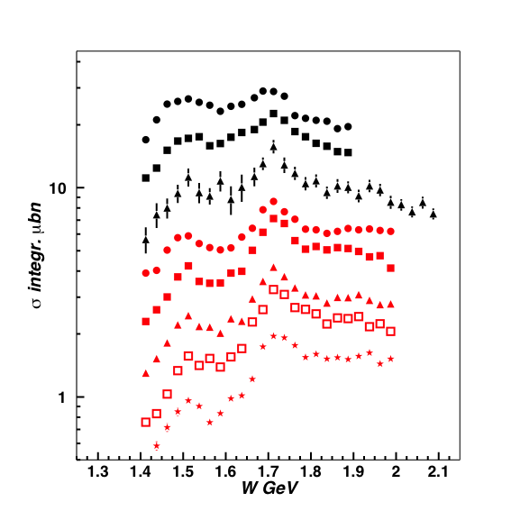
Future N* studies in π⁺π⁻p electroproduction with CLAS
γ_{v}NN*electrocouplings will become available for most excited proton states with masses less then 2.0 GeV and at photon virtualities up to 5.0 GeV²
Q² (GeV²)
0.65
0.95
1.30
2.30
2.70
3.30
D₃₃, P_{13 ,}F₁₅
3/2⁺(1720)
3.90
4.60
D₁₃
Extension of JM model toward high Q²
Resonance structures become more prominent with increasing Q².
Notes:
Many higher mass states couple dominantly to the 2-pion channel and can be best analyzed in this channel. One has 9 independent cross sections available that constrain analysis. The different curves show contributions from various isobars.

Slide 26
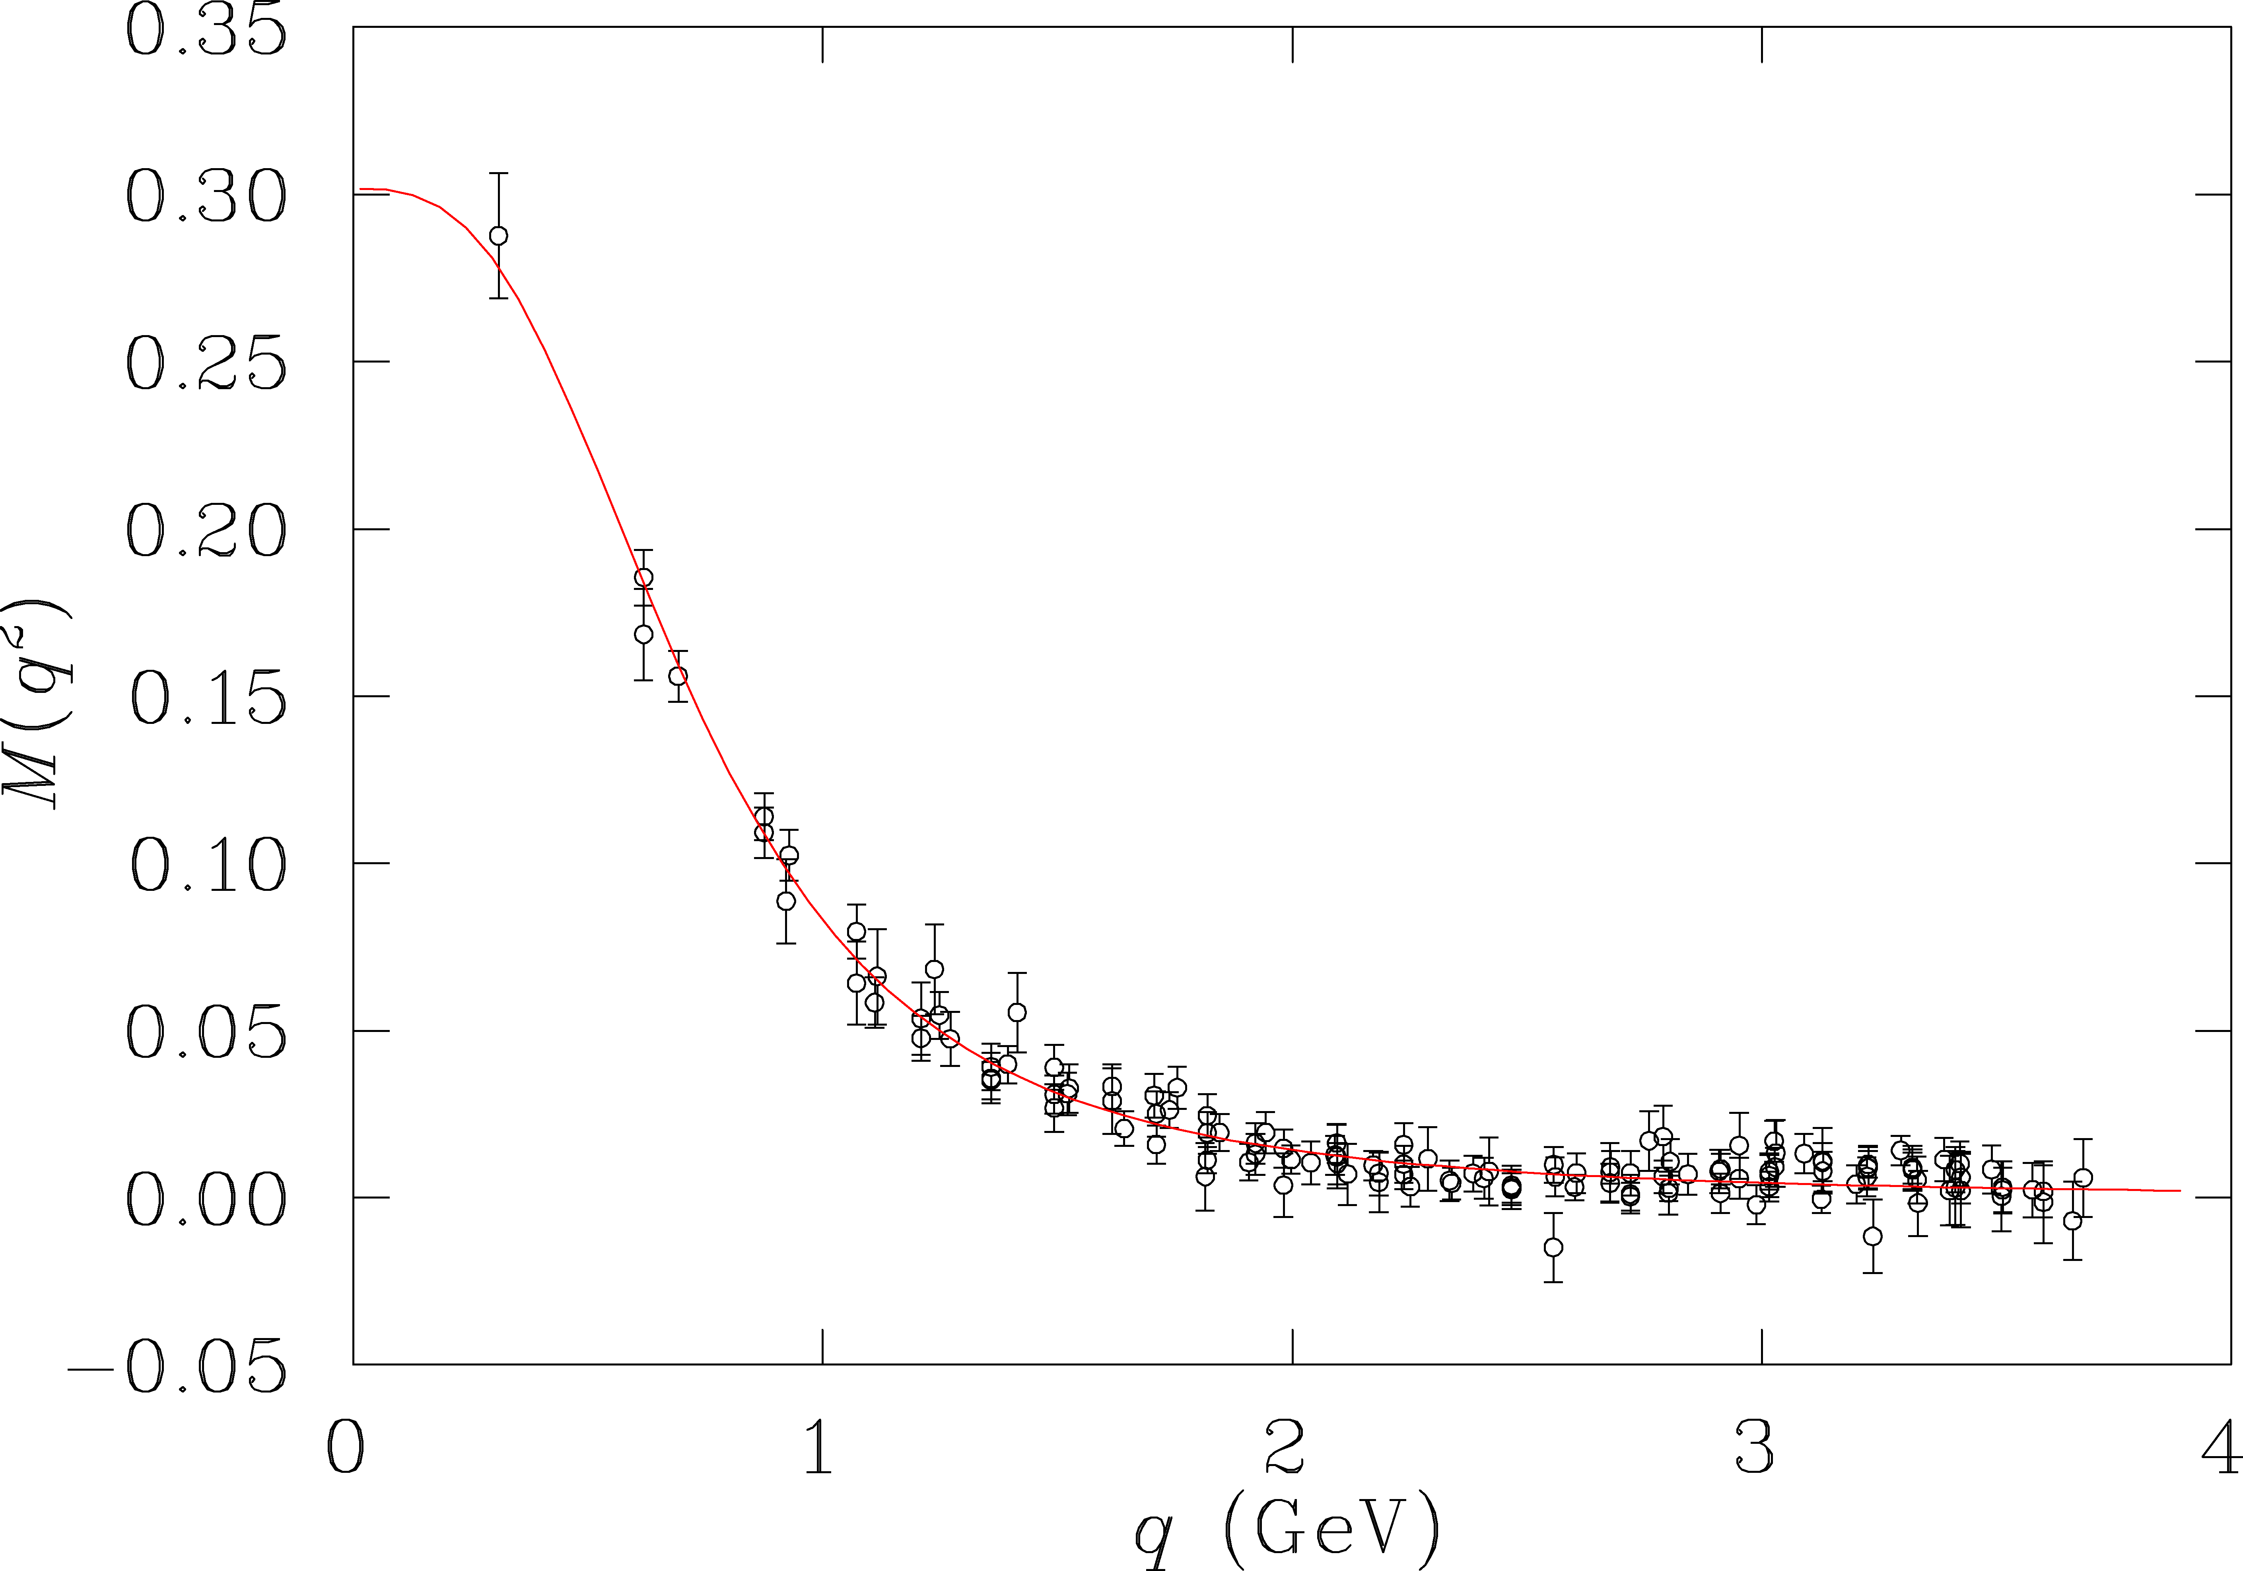
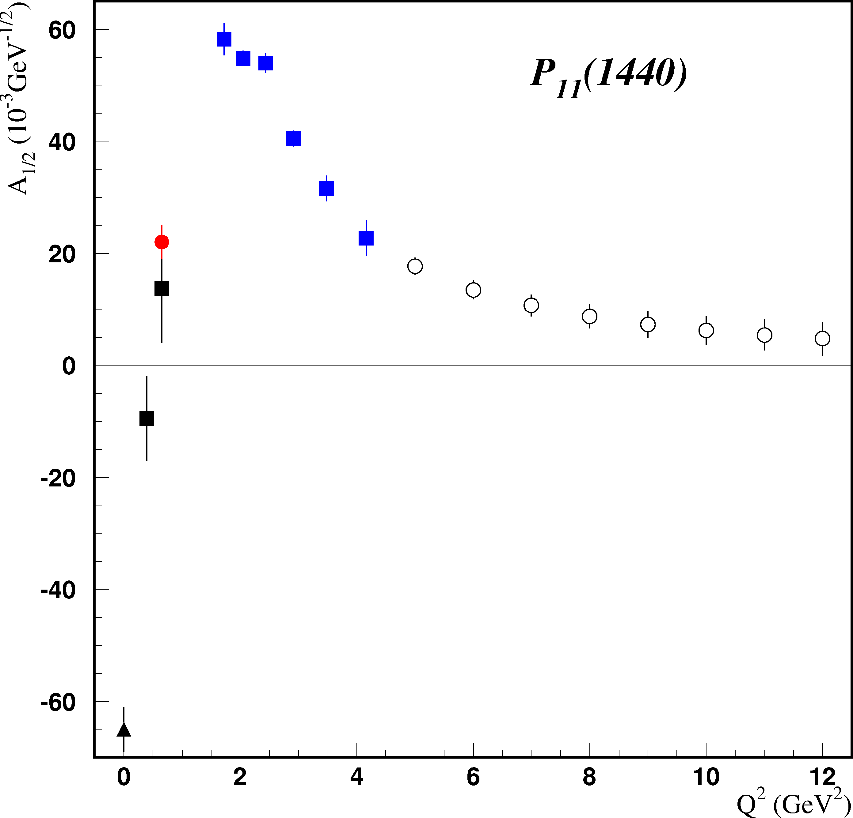
Resonance Transitions at 12 GeV
Experiment E12-09-003 will extend access to transition FF for many prominent states in the range to Q²=12GeV².
Electromagnetic form factors are sensitive to the effective quark mass.
accessible
at 6 GeV
quark mass (GeV)
accessible
at 12 GeV
CLAS12 projected
At 12 GeV we probe the transition from “dressed quarks” to elementary quarks.

Slide 27
Conclusions and Outlook
The measurements with CLAS in N* excitation region extended considerably data on Nπ electroproduction cross sections, various polarization asymmetries with full coverage of the final state phase space. Nine independent differential and fully integrated π⁺π⁻p electroproduction cross section were obtained for the first time.
Good description of the data on Nπ and π⁺π⁻p electroproduction was achieved, allowing us to separate resonant/non-resonant contributions, needed for the evaluation of γ_{v}NN* electrocouplings.
The data on G*_{M} form factor and R_{EM}, R_{SM} ratio for p→Δ transition were extended up to photon virtualitites 6.5 GeV². No evidence for the onset of pQCD was found.
For the first time electrocouplings of P₁₁(1440) andD₁₃(1520) states were determined from both Nπ and π⁺π⁻p electroproduction channels. Consistent results of independent analyses strongly support reliable evaluation of N* parameters.

Slide 28
Conclusions and Outlook
Comparison of the CLAS results on resonance electrocouplings with quark models expectation and the EBAC-DCC estimates of N* meson-baryon dressing showed that the structure of resonances with masses less then 1.6 GeV is determined by a combination of internal quark core and external meson-baryon cloud.
Preliminary results on electrocouplings of high lying S₃₁(1620), S₁₁(1650), F₁₅(1685), D₃₃(1700), and P₁₃₍1720) states have become available from π⁺π⁻p electroproduction for the first time
The recent CLAS data on π⁺π⁻p electroproduction will allow for the determination of electrocouplings of most excited proton states at photon virtulalities from 2.0 to 5.0 GeV² for the first time.
Joint effort in collaboration with the EBAC is in progress with the primary objective to obtain consistent results on N* parameters determined independently in analyses of major meson electroproduction channels and in the global coupled channel analysis within the framework of the EBAC-DCC model.

Slide 29
Back-up

Slide 30
con’d

Slide 31
Absorptive ansatz for phenomenological treatment of ISI & FSI in πΔ channels
K.Gottfried, J.D.Jackson, Nuovo Cimento 34 (1964) 736.
M.Ripani et al., Nucl Phys. A672, 220 (2000).

Slide 32
Cont’d
πΔ, ρp elastic scattering amplitudes
BW ansatz for resonant part
Exclude double counting: non-resonant ampl. &dressed gNN* verticies
T^{j}res →0.5T^{j}res f^{j}res=0
T^{j}backgr from πN data fit
Potential improvements:
New results on πΔ & ρp
elastic amplitudes

Slide 33
Extra contact terms in πΔ isobar channels
W=1.36 GeV Q²=0.43 GeV²
Parameters A(W,Q²), B(W,Q²) were taken from the CLAS data fit.
Born+
contact
Born

Slide 34
Non-resonant contributions in ρp isobar channel
Diffractive ansatz from J. D. Bjorken, PRD3, 1382 (1971).
Good approximation for t<1.0 GeV²; at larger t full ρp amplitudes are dominated by N*
b=b(L_{fluct}) from D.G.Cassel et al, PRD24, 2878 (1981).
JM model improvement A=A(W,Q²), essential in N* area at W<1.8 GeV:
L=0.77 GeV A=12
D_{λ}=0.30 GeV D=0.25 GeV
All details in:
N.V.Shvedunov et al, Phys of Atom. Nucl. 70, 427 (2007).

Slide 35
π⁺F₁₅(1685), π⁻P₃₃⁺⁺(1620) isobar channels
Evidence in the CLAS data
full JM results with
π⁺F₁₅(1685) and π⁻P₃₃(1620) implemented
full JM results without these channels
π⁺F₁₅(1685)
π⁻P₃₃(1620)
π⁺F₁₅(1685) amplitude:
π⁻P₃₃(1620) amplitude:

Slide 36
Fully integrated γ_{v}p→π⁺π⁻p cross sections, and the contributions from various isobar channels and direct 2π production
full calculation
Q²=0.95 GeV²
π⁻Δ⁺⁺
π⁺Δ⁰
π⁺ D₁₃(1520)
π⁺ F₁₅(1685)
ρ p
π⁺ P₃₃(1640)
direct 2π production

Slide 37
Input for Nπ/Nππ coupled channel analysis : partial waves of total spin J for non-resonant helicity amplitudes in π⁻Δ⁺⁺ isobar channel
J
1/2
Born terms
3/2
5/2
Extra contact terms
Will be used for N* studies in coupled channel approach developing by EBAC.

Slide 38
Meson-baryon dressing vs Quark core contribution in NΔ Transition Form Factor – G_{M.} EBAC analysis.
One third of G*_{M} at low Q² is due to contributions from meson–baryon (MB) dressing:
Data from exclusive π⁰ production
bare quark core
Within the framework of relativistic QM [B.Julia-Diaz et al., PRC 69, 035212 (2004)], the bare-core contribution is very well described by the three-quark component of the wf.
Q²=5GeV²
G_{D} =
1
(1+Q²/0.71)²

Slide 39
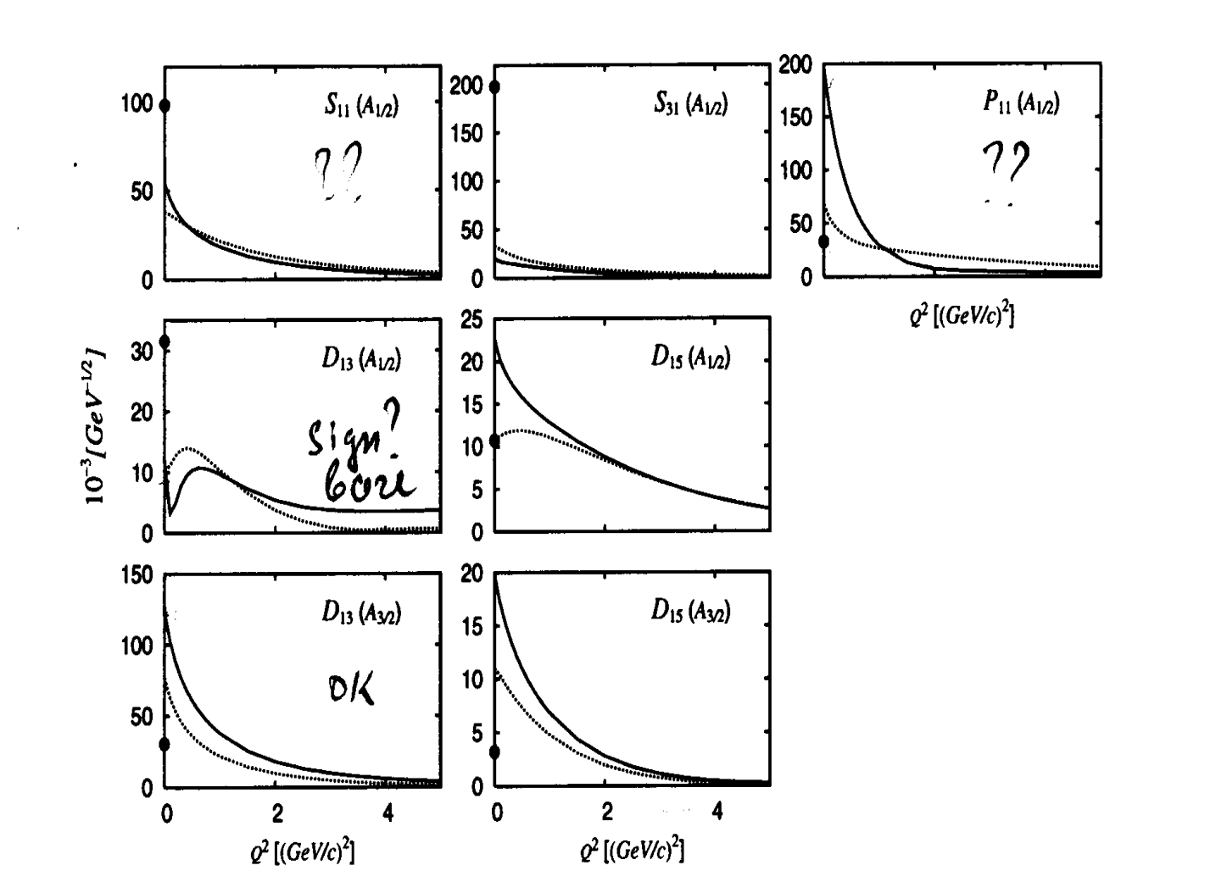
New regime in N* excitation at high Q²
EBAC calculations for meson-baryon cloud of low lying N*’s.
the photons of high virtuality penetrate meson-baryon cloud and interact mostly to quark core
data on N* electrocouplings at high Q² allow us to access quark degrees of freedom, getting rid of meson-baryon cloud.
can be obtained at 5<Q²<10 GeV² after 12 GeV Upgrade with CLAS12 for majority of N* with masses less then 3.0 GeV
B.Julia-Diaz, T-S.H.Lee, et.al, Phys. Rev. C77, 045205 (2008).

Slide 40
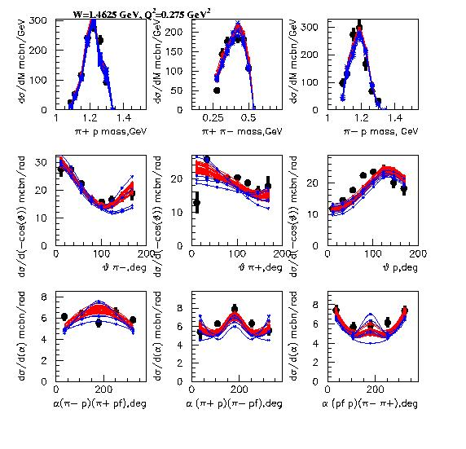
Robustness of the data on P11(1440) electrocouplings
P11 on
P11 is substituted by non-resonant mechanisms
Q² independent fit
Q² dependent fit
2.6<χ2/d.p.<2.8
3.6<χ2/d.p.<4.0

Slide 41
High lying resonance electrocouplings from Nππ CLAS data analysis
A_{1/2}
A_{3/2}
S_{1/2}
N(1685)F₁₅
The amplitudes of
unitarized BW ansatz
A_{1/2}
S_{1/2}
γ_{v}
M
N*₁
N*₁
p
diagonal
B
N(1650)S₁₁
γ_{v}
M
N*₁
N*₂
Unitarization of full BW amplitudes was achieved accounting for all interactions between N*’s in dressed resonant propagator
p
off-diagonal
B

Slide 42
Electrocouplings of [70,1-] SU_{sf}(6)-plet states from Nπ/Nππ CLAS data and their description in SQTM approach
D₁₃(1520)
SU(6) spin-flavor symmetry for quark binding interactions
Dominant contribution from single quark transition operator:
D₁₃(1520)
World data before CLAS measurements on transverse electrocouplings of D₁₃(1520) and S₁₁(1535) states (the areas between solid lines) allowed us to predict transverse electrocouplings for others [70,1-] states (the areas between solid lines on the next slide), utilizing SU(6) symmetry relations.
S₁₁(1535)
V.D. Burkert et al., Phys. Rev. C76, 035204 (2003).

Slide 43
Electrocouplings of [70,1-] SU_{sf}(6)-plet states from Nπ/Nππ CLAS data and their description in SQTM approach
SQTM predictions are consistent with major features in Q² evolution of [70,1-] state electrocouplings, offering an indication for:
relevance of quark degrees of freedom and substantial contribution to quark binding from interactions that poses SU(6) spin-flavor symmetry
considerable contribution to N* electroexcitations at Q²<1.5 GeV² from single quark transition
S₃₁(1620)
A_{1/2}
D₃₃(1700)
S₁₁(1650)
D₃₃(1700)
A_{3/2}

Slide 44
Electrocouplings of [70,1-] SU_{sf}(6)-plet states from Nπ/Nππ CLAS data in comparison with quark model expectations
Nππ preliminary
Nπ
D₁₃(1520)
D₁₃(1520)
Light front models:
S.Capstick:
each N* state is described by single h.o. 3q configuration
S₁₁(1535)
S₁₁(1650)
S.Simula:
Mass operator is diagonalized, utilizing a large h.o. basis for 3q configurations

Slide 45
Electrocouplings of [70,1-] SU_{sf}(6)-plet states from Nπ/Nππ CLAS data in comparison with quark model expectations
The CLAS data on N* electrocouplings are better described accounting for 3q configuration mixing, showing importance of this effect in the N* structure.
Remaining shortcomings may be related to more complex qq interactions than OGE, utilized in S.Simula model.
S₃₁(1620)
First information on electrocouplings of [70,1-]-plet and several other N*’s N* states, determined from the CLAS Nπ/Nππ data, open up a promising opportunity to explore binding potential and qq interaction based on the fit of all available N* electrocouplings combined within the framework of quark models and taking into account MB cloud.

Slide 46
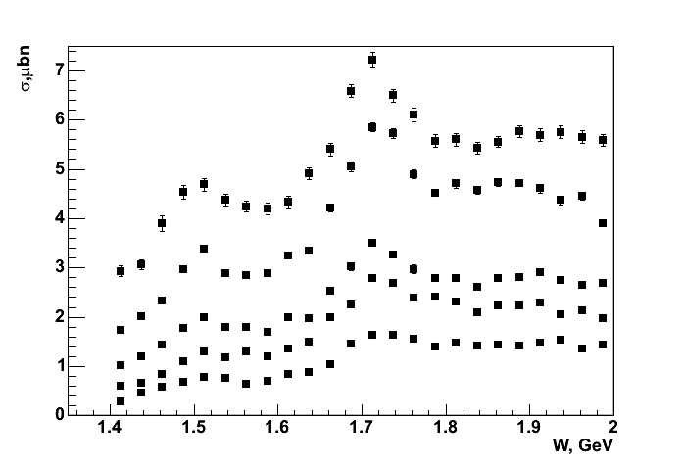
Fully integrated γp→π⁺π⁻p cross sections at 2.0<Q²<5.0 GeV²
Resonant structures are clearly seen in entire Q² area covered by CLAS detector with 5.75 GeVe⁻ beam. The structure at W~1.7 GeV becomes dominant as Q² increases
Q²=2.4 GeV²
CLAS Preliminary
Q²=2.7 GeV²
Q²=3.3 GeV²
Q²=3.9 GeV²
Q²=4.6 GeV²
D13(1520)
P11(1440)
D33(1700),P13(1720)
3/2⁺(1725),F15(1685)

Slide 47
Comparison between the CLAS and MAID results
P₁₁(1440)
S_{1/2}
A_{1/2}
MAID07
MAID08

Slide 48
Comparison between the CLAS and MAID results
D₁₃(1520)
S_{1/2}
A_{3/2}
A_{1/2}
MAID07
MAID08

